Slide 1
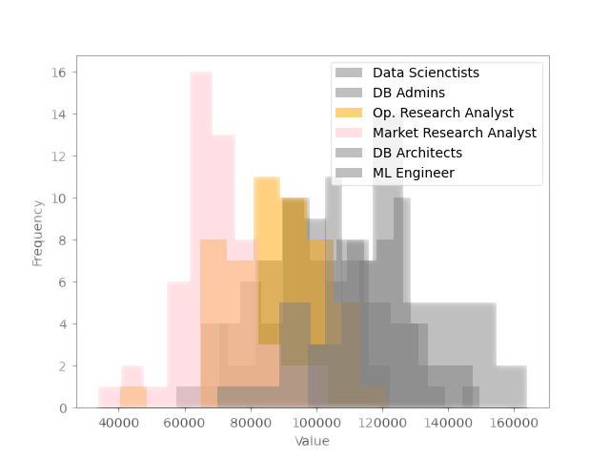
Business Analysts Cover the Rear

Slide 2
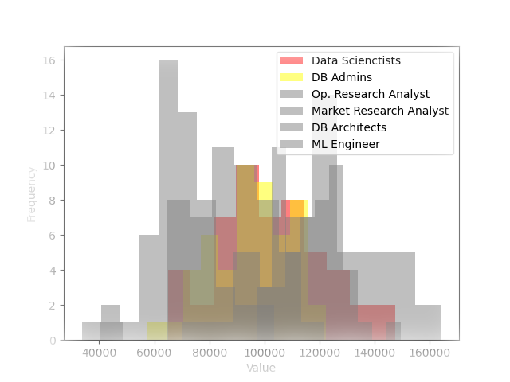
Scientists and Admins Center the Pack

Slide 3
Scientists and Admins Center the Pack

